Slide 1
Why Do Firms Both Make and Buy?
An Investigation of Concurrent Sourcing
Anne Parmigiani
Strategic Management Journal (2007)
Modified and presented by Carter Zagorski, Spring 2023

Slide 2
Introduction
Most theories of the firm view the sourcing decision as a dichotomous choice: to make or to buy. However, firms can and do simultaneously make and buy the same good, a phenomenon this article terms concurrent sourcing.
To achieve concurrent sourcing, the firm must incur both organization costs and transaction costs.
Q1: Given that concurrent sourcing is more costly to set up and manage, why would firms select this sourcing mode over solely making or solely buying?
Q2: Is concurrent sourcing at a point along the make/buy continuum or a discrete choice?

Slide 3
Theories and Hypotheses
Transaction Cost Economics
The assumption of a make-or-buy continuum. “Discrete market exchange at the one extreme to hierarchical organization at the other, which myriad of intermediate modes filling the range in between” (Williamson, 1985).
Emphasis on transaction characteristics. TCE emphasizes transaction costs as the driver for vertical integration and suggests the firm would ‘never integrate for production cost reasons alone’ (Williamson, 1985).
This may be the case for full integration, but for partial integration (i.e., concurrent sourcing), aspects of production costs such as economies of scope might matter.

Slide 4
Theories and Hypotheses
Transaction Cost Economics
H1_{TCE}: Moderately asset-specific goods will be concurrently sourced.
H2_{TCE}: Goods with a moderate level of volume uncertainty will be concurrently sourced.
Unpredictability of demand and an accompanying inability to accurately forecast and schedule production
H3_{TCE}: Goods with a moderate level of performance uncertainty will be concurrently sourced.
The difficulty in predicting how a good will perform in the firm’s subsequent production processes

Slide 5
Theories and Hypotheses
Neoclassical Economics
Hedging against Uncertainty
A firm can keep its internal plant at full production by using suppliers to handle fluctuating additional volumes.
Neither completely making nor completely buying will sufficiently resolve the uncertainty due to having this flexibility in capacity.
H2_{NEO}: The greater the good’s volume uncertainty, the more likely the firm will concurrently source.

Slide 6
Theories and Hypotheses
Neoclassical Economics
Information asymmetry
By using both internal and external suppliers, the sourcing firm will learn more about production technology and have greater access to cost-saving measures.
Concurrent sourcing enables the firm to credibly threaten to switch suppliers by either totally vertically integrating or completely outsourcing its requirements, thus disciplining both internal and external suppliers.
H3_{NEO}: The greater the performance uncertainty of the good, the more likely the firm will concurrently source.

Slide 7
Theories and Hypotheses
Neoclassical Economics
Economies of scope
Neoclassical economics emphasizes the production function and its associated costs as the motivator for a firm’s sourcing decision.
When both the firm and the supplier can reduce production costs through economies of scope, the firms would be motivated to make and buy simultaneously in order to enjoy both lower internal costs and low supplier prices.
H4_{NEO}: The greater scope economies for both the firm and its suppliers to produce the good, the more likely the firm will concurrently source.

Slide 8
Theories and Hypotheses
The capabilities view
Firm’s expertise
The greater a firm’s (a supplier’s) expertise, the greater its degree of internalization (outsourcing).
If both the firm and the supplier have significant expertise, the firm will be motivated both to make, to take advantage of its own expertise, and to buy, to learn from suppliers.
H5_{CAP}: The greater the expertise of both the firm and its suppliers, the more likely the firm will concurrently source.

Slide 9
Methods
Research Setting
Metal stamping and powder metal firms for production tooling and services
Consisting of numerous independent, mature small firms; homogeneous production process; mature technology
Data and sample
After on-site interviews with managers from 11 metal forming firms, mail surveys were sent to 453 firms (366 in stamping and 87 in powder metal) to collect data on the sourcing decisions of five production-related goods: die design, die building, die maintenance, end-part machining, and end- part surface coating
Final sample used in the analysis includes 804 observations originating from 193 firms (43% response rate)

Slide 10
Methods
Measures
DV: Sourcing mode choice -- Internally, externally, or concurrently (percentage of internal production)
IV: Asset specificity (market thinness), volume uncertainty, performance uncertainty, technological uncertainty, scope economies, expertise
Controls: # of employees, firm age, unionization, firm type, scale economies, volume required, input similarity
Models
Ordered Logit vs. Multinomial Logit
Ordered logit is used when DV is ordinal categories, while multinomial logit is used when DV is distinct choices.
Comparing the fitness of the two models

Slide 11
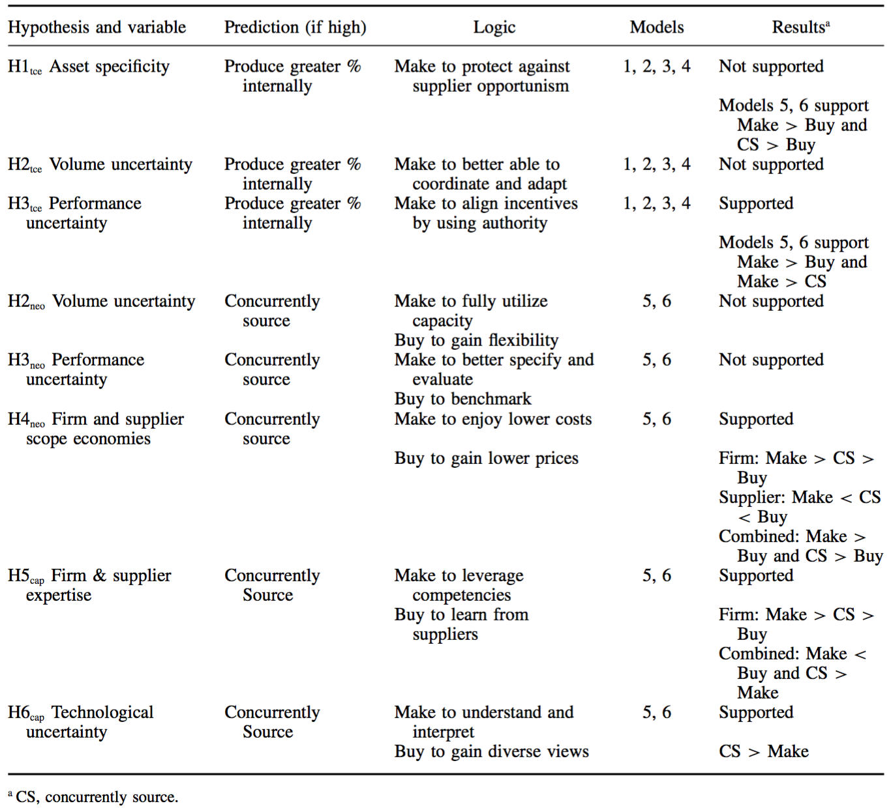
Results

Slide 12
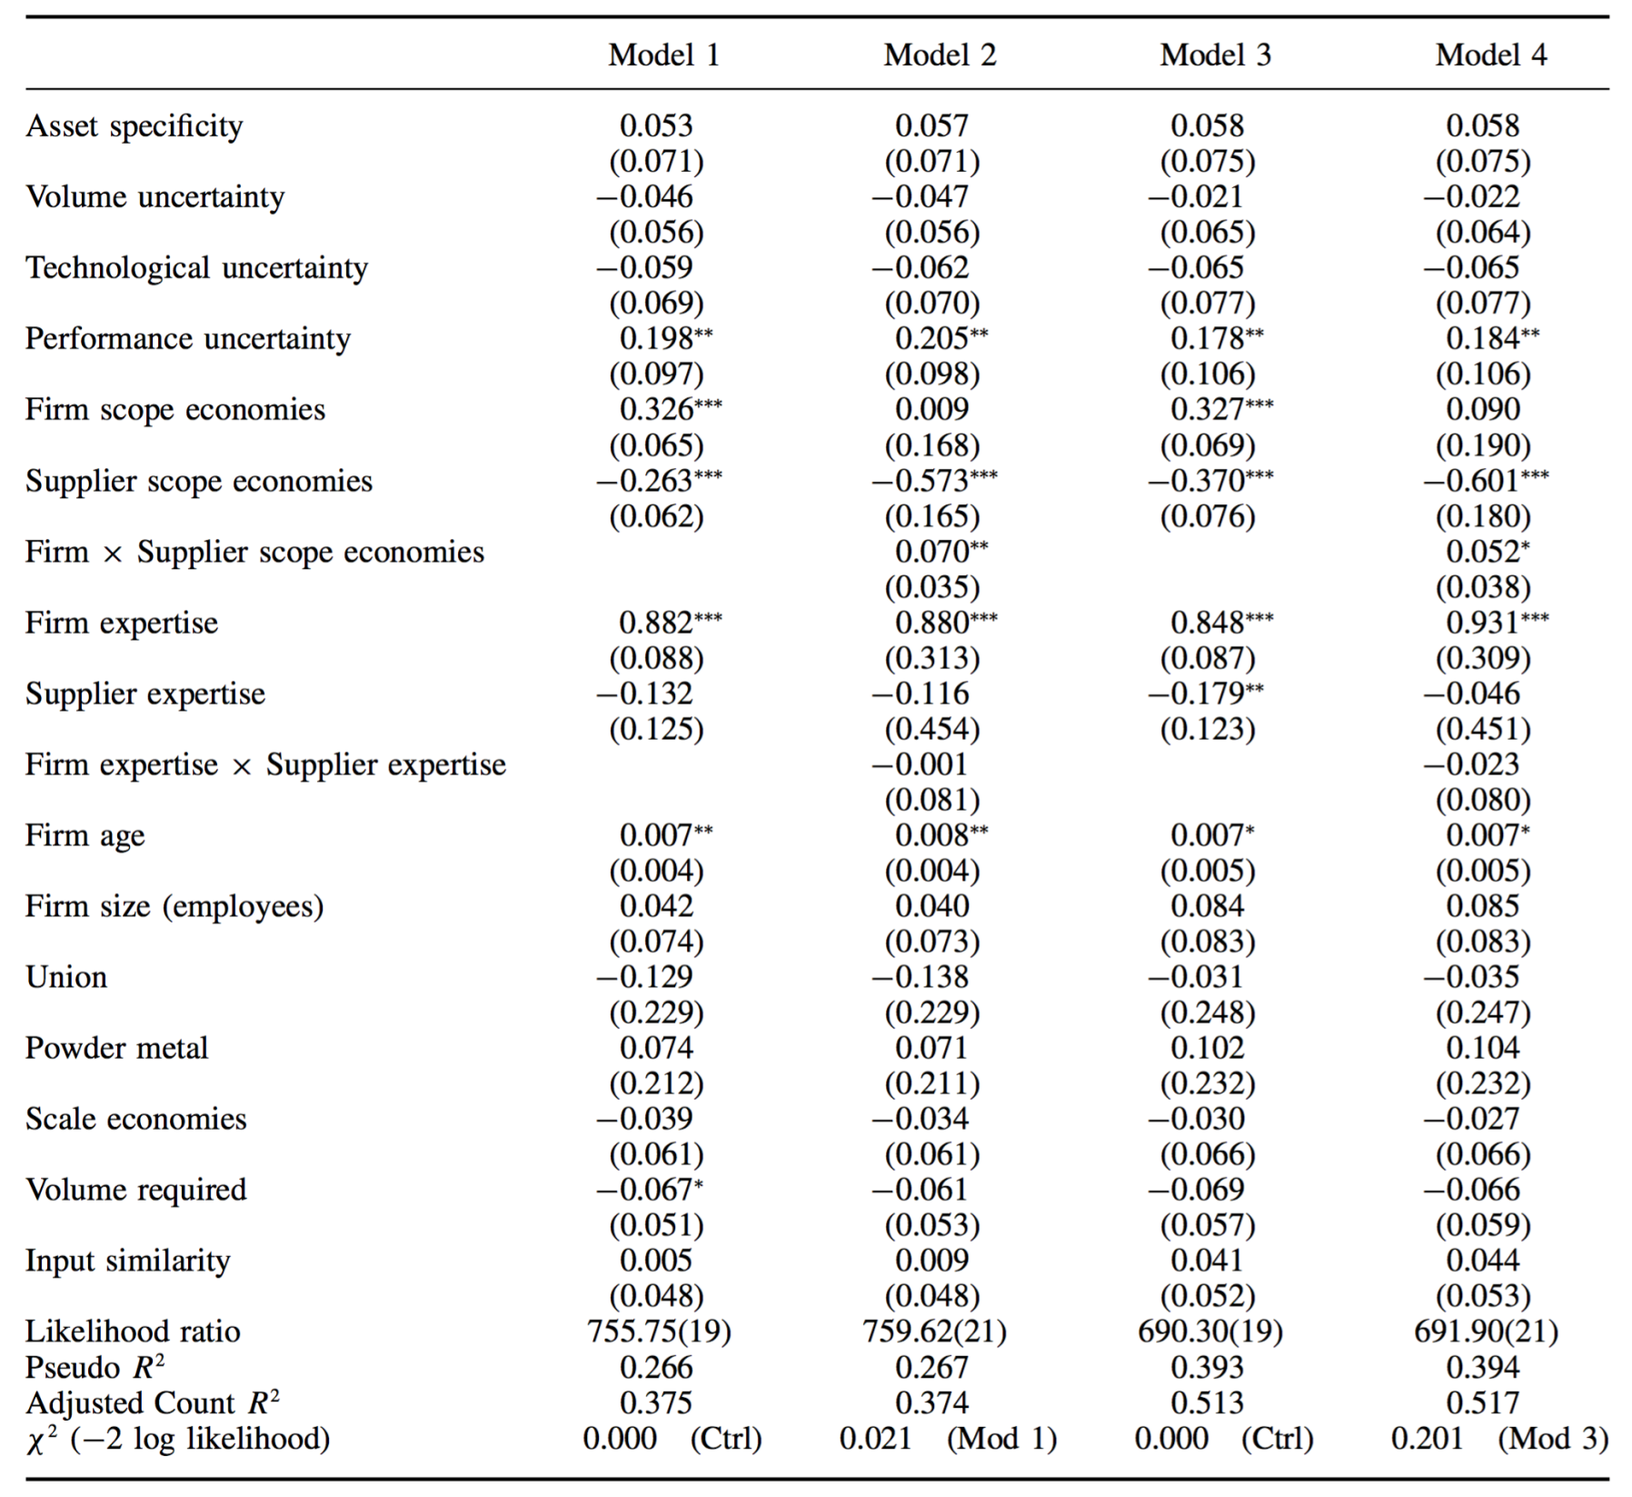
Results

Slide 13
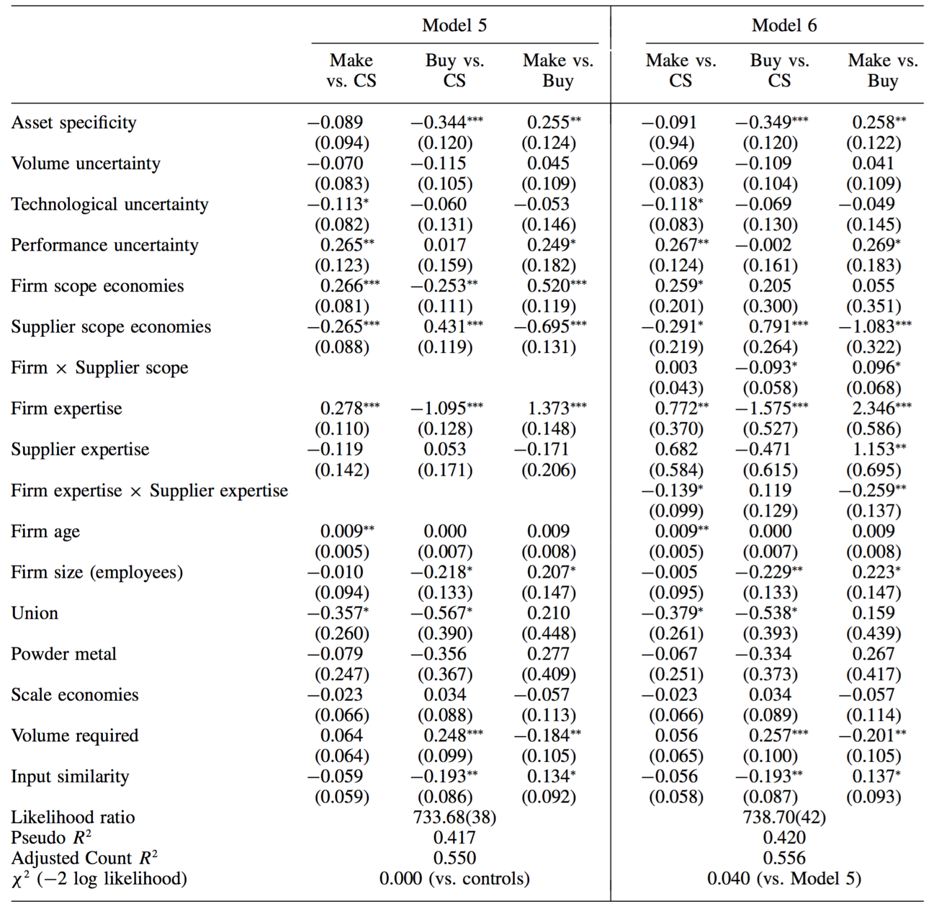
Results

Slide 14
Conclusions
All three theories contribute to the governance choice of sourcing mode.
TCE: firms are more likely to make when markets are thin and performance uncertainty is great.
The neoclassical economics: greater firm and supplier scope economies lead to concurrent sourcing.
The capabilities view: greater combined firm and supplier expertise as well as higher technological uncertainty led to concurrent sourcing.
The superiority of the multinomial over the ordered logit models supports the concurrent sourcing as a plural governance mode.
We can gain a better understanding of hybrid mode.
Some factors may motivate a firm toward one mode but not necessarily away from another.

Slide 15
Discussion
Despite the benefits of concurrent sourcing derived from combining the advantages of each mode, adopting concurrent sourcing also incurs both types of cost. Whether and under what conditions can concurrent sourcing benefit firm performance?
This study only focuses on independent goods while overlooking the complementarity between goods, for example, die design and die building are complements. What factors may affect firms’ joint sourcing decision for a set of complementary goods? (e.g., absorptive capacity of the focal firm; whether suppliers have highly specialized or somewhat redundant skills)

